Slide 1

NDI DIGITAL INITIATIVE PROGRAM · SOUTHWEST REGION
Upstream Production Optimization & Predictive BOE Analytics
Data Analytics
PRESENTED BY
· Fatoye Yetunde ·

Slide 2




PORTFOLIO ANALYTICS
The Business Problem
The organization lacked a unified framework linking production performance to financial outcomes. Management needed answers to four critical questions.
Production Drivers
Operational Impact
Which fields and wells drive overall production?
How do operational factors affect BOE performance?
Financial Translation
Risk Exposure
How does production translate into revenue and profit?
What operational risks could threaten future profitability?
Predictive Asset Management · NDI Digital Initiative — Southwest Region
2

Slide 3
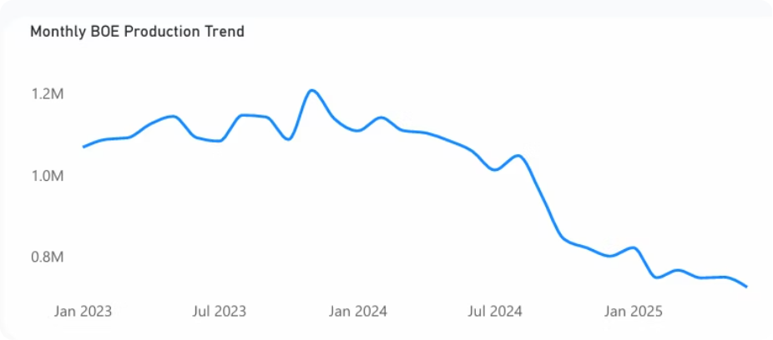
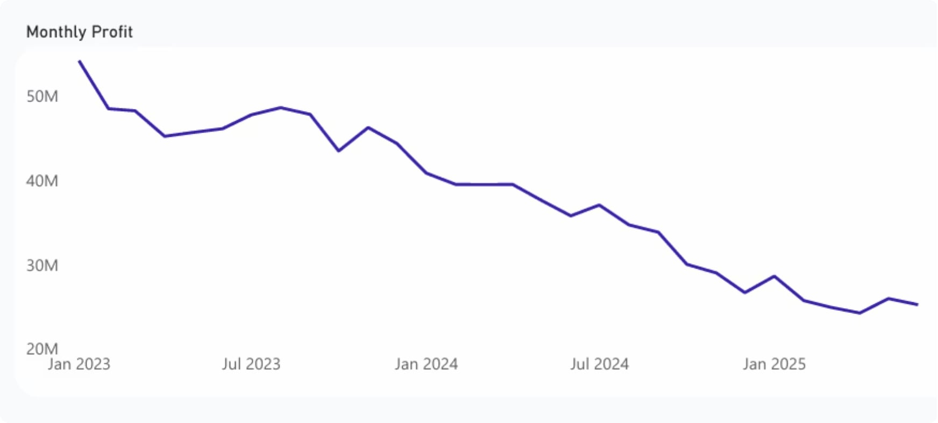
PORTFOLIO ANALYTICS
Portfolio Financial Performance
Strong production performance drives financial success across the portfolio.
30M
BOE PRODUCED
Total portfolio production output
$1.26B
REVENUE GENERATED
Total portfolio revenue
$1.15B
PROFIT ACHIEVED
Approximate total portfolio profit
Higher BOE production directly contributes to higher revenue and profitability — confirming production as the primary financial driver.
Monthly profit trend — reinforcing the production-to-profit linkage.
Predictive Asset Management · NDI Digital Initiative — Southwest Region
3

Slide 4
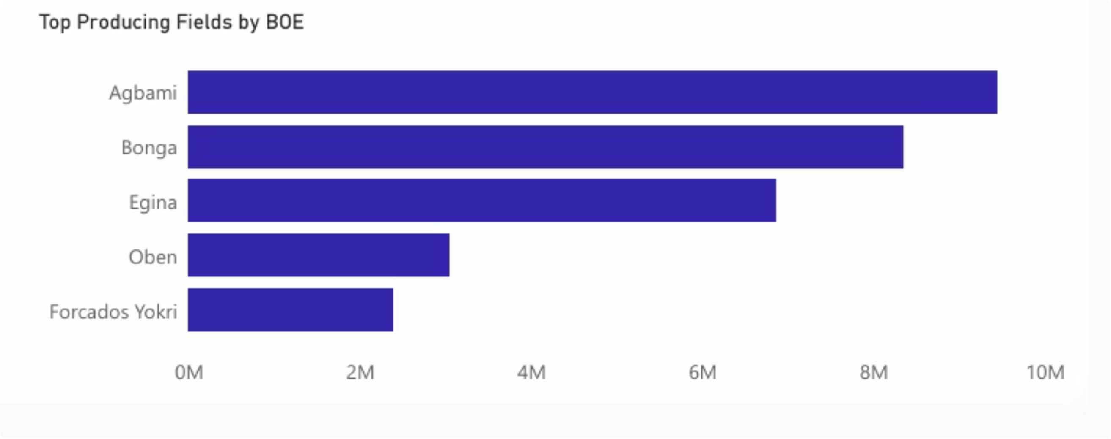

PORTFOLIO ANALYTICS
Production Concentration: Strategic Asset Dependency
Key Finding
Agbami and Bonga contribute the largest share of total BOE production and account for the highest revenue contribution. Production and revenue streams are highly dependent on a small number of strategic assets.
Risk
Disruption within these assets could significantly affect overall company performance.
Top producing fields by BOE — Agbami and Bonga dominate.
Predictive Asset Management · NDI Digital Initiative — Southwest Region
4

Slide 5
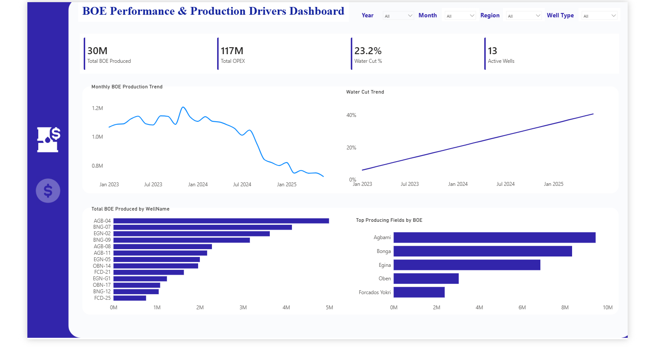



PORTFOLIO ANALYTICS
From Raw Data to Actionable Insight
An interactive dashboard consolidates production, financial, and operational metrics into a single decision-support view.
Portfolio KPIs
BOE, revenue and profit at a glance
Drill-down analysis
Field, well and time-period views
Faster decisions
One source of truth for Operations
Predictive Asset Management · NDI Digital Initiative — Southwest Region
5

Slide 6
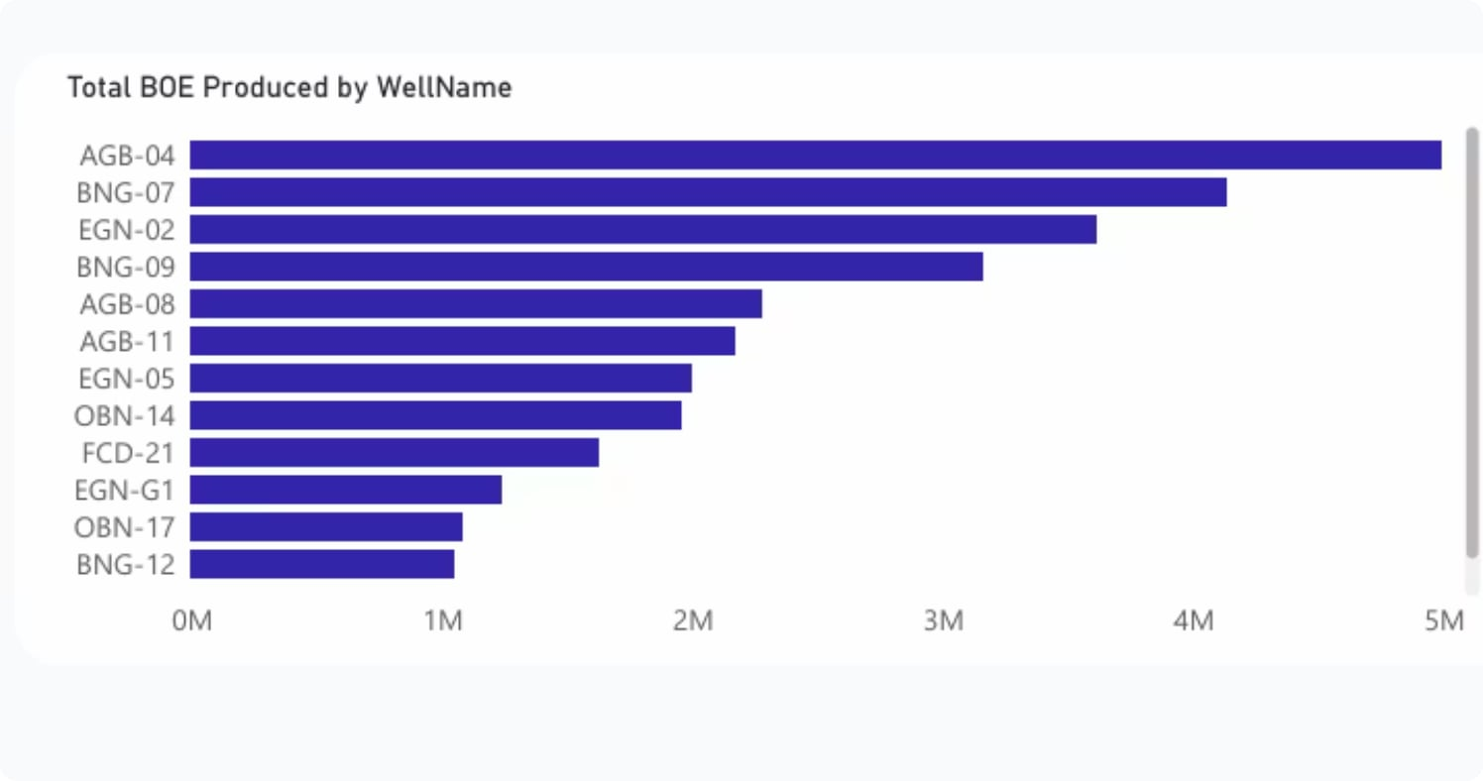



HIGH-PRODUCING WELLS
Primary Value Drivers
A small group of wells contributes a substantial share of total BOE production — generating the majority of revenue and profit across the portfolio.
Revenue Concentration
Top wells generate the majority of portfolio revenue and profit.
Maintenance Priority
Proactive maintenance of these critical wells is essential to sustaining future profitability.
Operational Monitoring
Continuous monitoring enables early detection of performance issues before they impact financial outcomes.
6

Slide 7
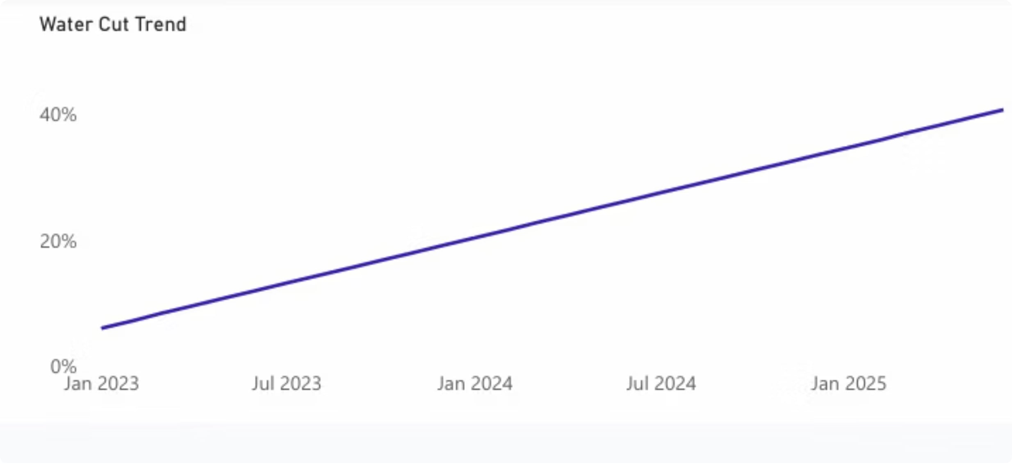



PORTFOLIO ANALYTICS
Water Cut: A Critical Operational Metric
Water cut analysis monitors reservoir health and production efficiency. Rising water production directly impacts costs and profitability if not properly managed.
Higher Treatment Costs
More produced water requires more processing capacity.
Increased Operating Expenses
Water handling adds directly to overall OPEX.
Reduced Production Efficiency
Water displacement reduces hydrocarbon output.
Predictive Asset Management · NDI Digital Initiative — Southwest Region
7

Slide 8

PORTFOLIO ANALYTICS
Production Trends & Future Revenue Outlook
Monitor BOE
Track production trends over time.
Detect Decline
Identify early signs of a sustained drop.
Act Proactively
Intervene before revenue is impacted.
Monthly BOE production trend — a sustained decline threatens future revenue.
Because revenue depends largely on production output, trend monitoring is the natural entry point for predictive modeling — the focus of the next section.
Predictive Asset Management · NDI Digital Initiative — Southwest Region
8

Slide 9
THE WAY FORWARD
Strategic Recommendations
01
Production Optimization Monitor BOE trends to identify early signs of decline and support proactive intervention planning.
02
Asset Protection Prioritize maintenance for top-performing fields and wells — particularly Agbami and Bonga.
03
Water Management Implement targeted strategies to reduce water handling costs and improve production efficiency.
04
Profitability Enhancement Focus capital investment on high-producing, high-revenue assets while optimizing operating expenses.
05
Predictive Decision-Making Leverage the deployed forecasting and anomaly models to anticipate asset performance and improve operational planning.
Predictive Asset Management · NDI Digital Initiative — Southwest Region
13

Slide 10


CONCLUSION
The Business Insight
The analysis demonstrates a strong connection between operational performance and financial outcomes — the fields and wells generating the highest BOE production also contribute the greatest share of revenue and profitability.
Production Optimization
Asset Reliability
Water Management
Sustain output levels to protect revenue.
Protect top-performing fields and wells.
Control costs and maintain efficiency.
Continued focus on these three pillars will be critical to sustaining long-term value creation and maximizing asset profitability.
Predictive Asset Management · NDI Digital Initiative — Southwest Region
14

